Slide 1

UNIVERSITY OF RAJSHAHI
Crop Recommendation System Using Machine Learning
Presented By: | Supervised By:
Dipa Rani Sarker ID: 2037820121 Session: 2019-2020 | Md. Hasibul Alam Lecturer, Dept. of CSE. TMSS Engineering College, Bogura.

Slide 2
Overview
Introduction
Objectives
Proposed Methodology
Model Training & Result Analysis
Web Application
Future Work
Conclusion
References

Slide 3
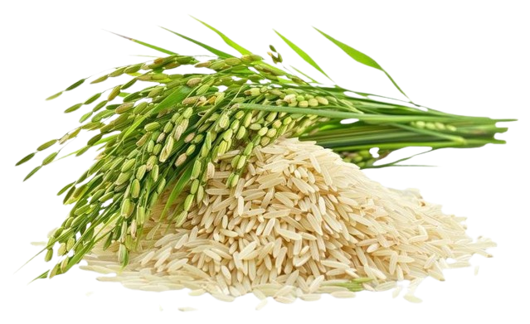
Introduction
Improving agricultural productivity is essential for ensuring food security and supporting sustainable growth. This project introduces a Machine Learning-based Crop Recommendation System to make farming smarter and more efficient.
Developed using Python, it analyzes key factors like soil nutrients, temperature, humidity, pH, and rainfall. A user-friendly web application has been built using Flask, making it easy and intuitive for farmers to use.
1/20

Slide 4
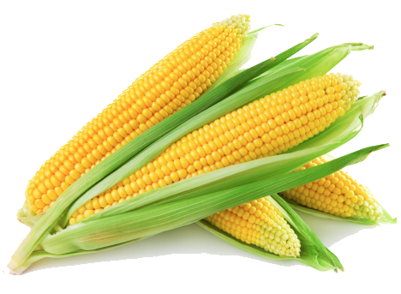
Objectives
Develop a system that recommends crops based on input data (e.g., soil nutrients, temperature, humidity, pH etc.).
Use machine learning models for prediction and better selection.
Integrate the chosen model into a Flask web app so that it’s easy to use and accessible to anyone through a simple web interface.
Provide a better user-friendly web interface for users.
2/20

Slide 5
Proposed Methodology

Slide 6
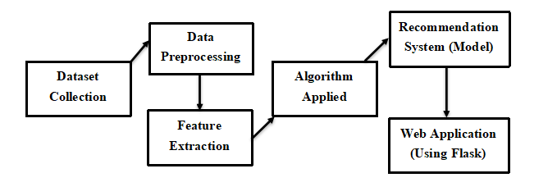
Block Diagram Showing the Overall Methodology
Fig. 1: Overview of the Proposed Methodology.
3/20

Slide 7
Dataset
In this project, I used a reliable Crop Dataset from Kaggle.
The dataset contains 2200 instances and 8 attributes.
Used 80% data for training (1760 instances) and 20% for testing (440 instances).
Attributes | Meaning
N | The ratio of Nitrogen content in soil.
P | The ratio of Phosphorous content in soil.
K | The ratio of Potassium content in soil.
temperature | The temperature in degree Celsius.
humidity | Relative humidity in %.
ph | The pH value of the soil.
rainfall | Rainfall in mm.
label | The target attribute, specifying the recommended crop.
Table. 1: Descriptions of the attributes of the dataset.
4/20

Slide 8
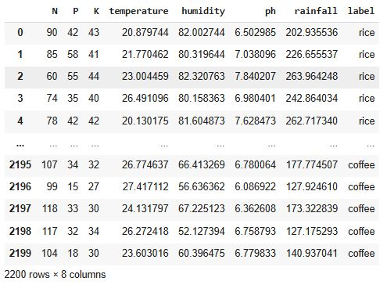
Data Frame of the Dataset
Fig. 2: Data frame of the dataset.
5/20

Slide 9
Data Preprocessing
These are the key steps involved in data preprocessing:
Identifying and removing duplicate records.
Identifying and handling null and zero (0) values.
Checking and handling missing values and outliers.
Encoding categorical attributes into a numeric format.
6/20

Slide 10
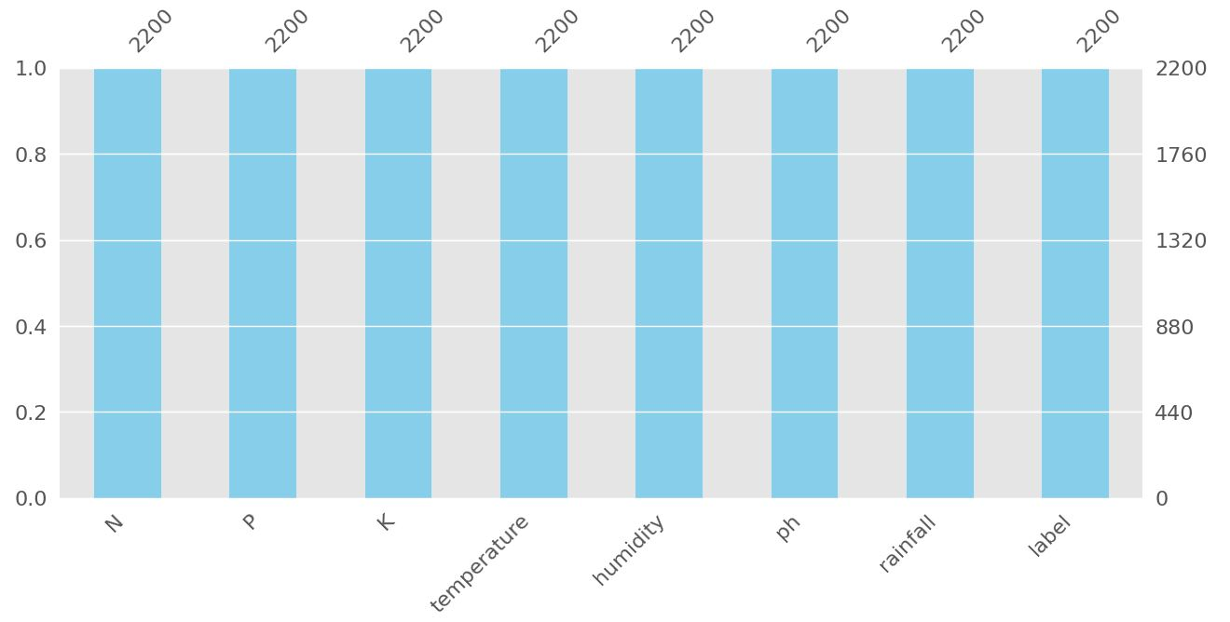
Visualizing Missing Data
Fig. 3: Bar chart of the missing values in the dataset.
7/20

Slide 11
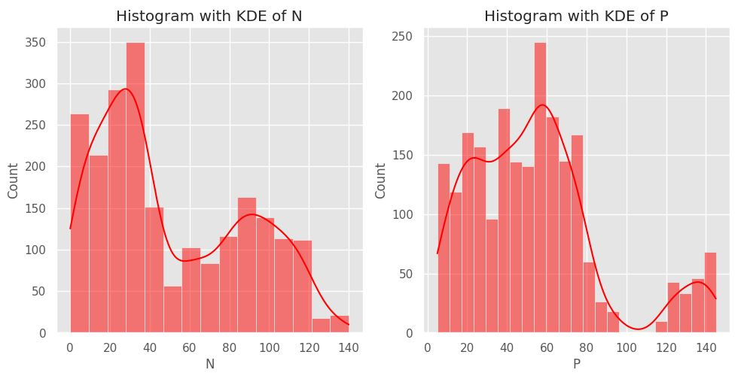
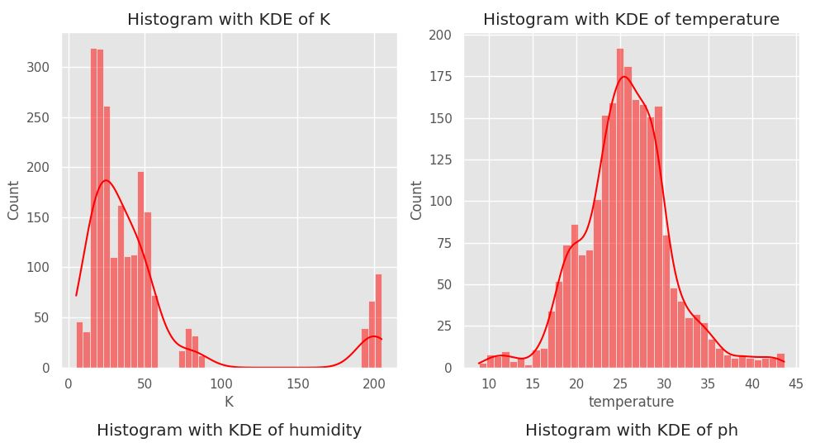
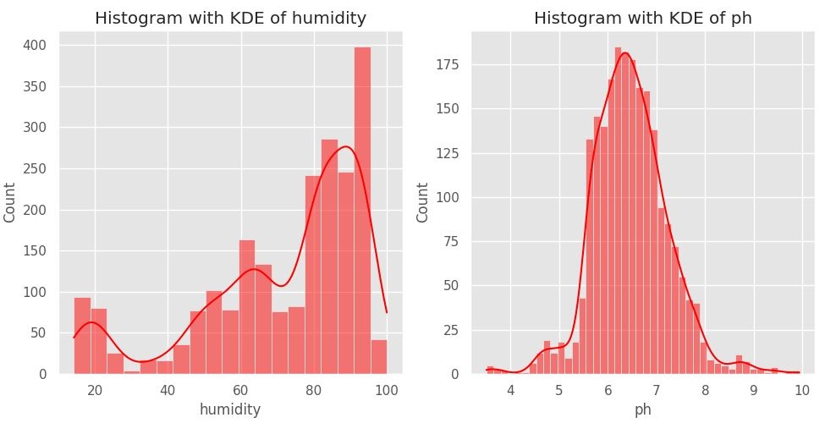
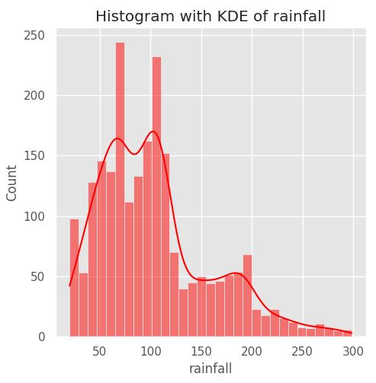
Feature Analysis Using Histogram
(a) (b) (c) (d)
(e) (f) (g)
Fig. 4: Histogram with KDE of (a) N, (b) P, (c) K, (d) temperature, (e) humidity, (f) ph and (g) rainfall.
8/20

Slide 12
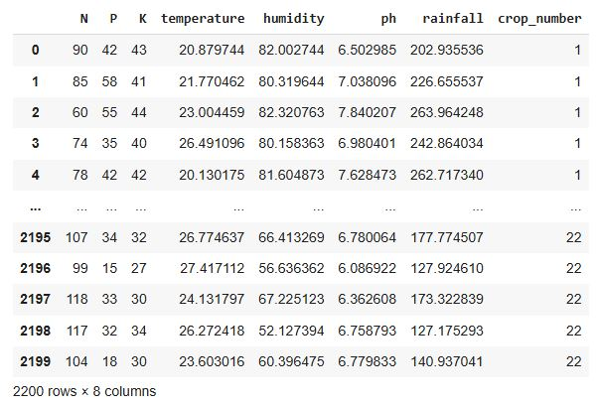
Encoding Target Column “label”
Fig. 5: Data frame of the dataset after encoding “label” column to “crop_number”.
9/20

Slide 13
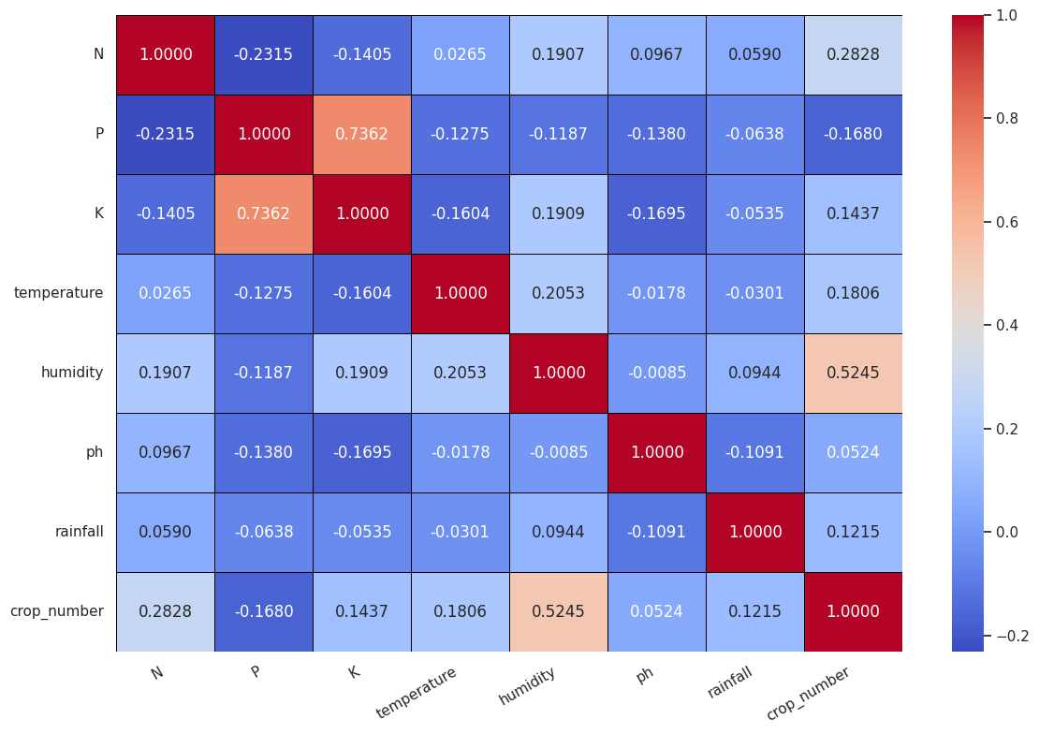
Feature Analysis (Correlation Matrix)
Fig. 6: Correlation Matrix.
10/20

Slide 14
Model Training & Result Analysis

Slide 15
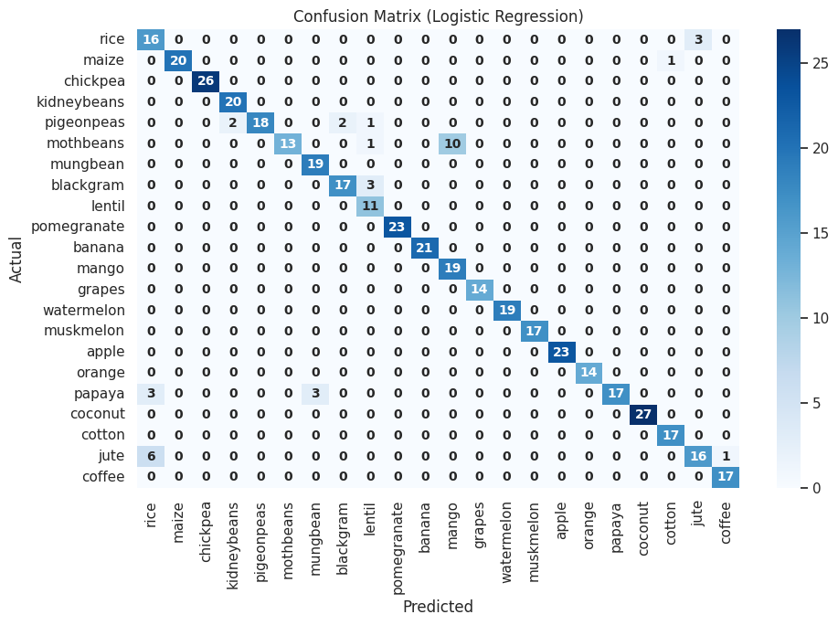
Logistic Regression Model Performance Analysis
Fig. 7: Confusion matrix of Logistic Regression. Table. 2: Logistic Regression model’s performance metrics.
Performance Metrics | Score (%)
Train Accuracy | 94.77
Test Accuracy | 91.82
Precision | 91.82
Recall | 91.82
F1-Score | 91.82
11/20

Slide 16
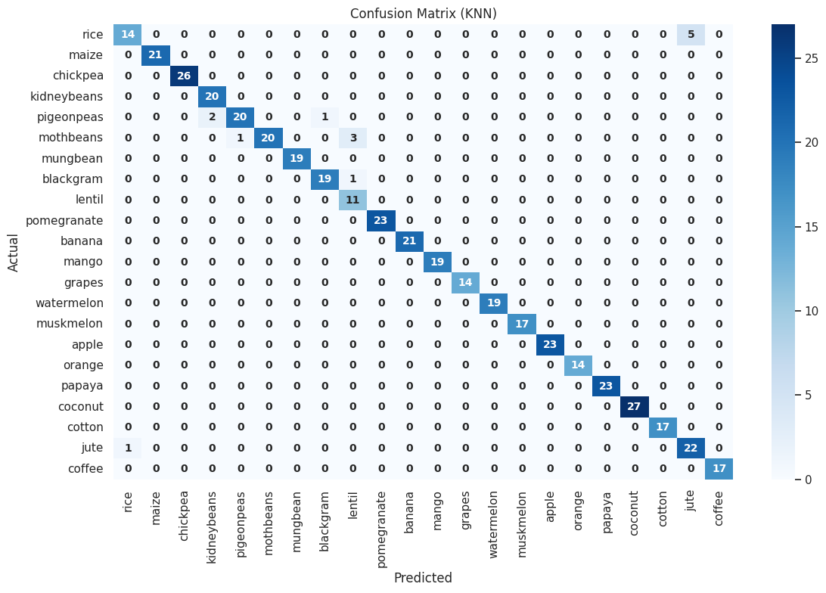
K-Nearest Neighbors (KNN) Model Performance Analysis
Fig. 8: Confusion matrix of KNN. Table. 3 : KNN model’s performance metrics.
Performance Metrics | Score (%)
Train Accuracy | 99.09
Test Accuracy | 96.82
Precision | 96.82
Recall | 96.82
F1-Score | 96.82
12/20

Slide 17
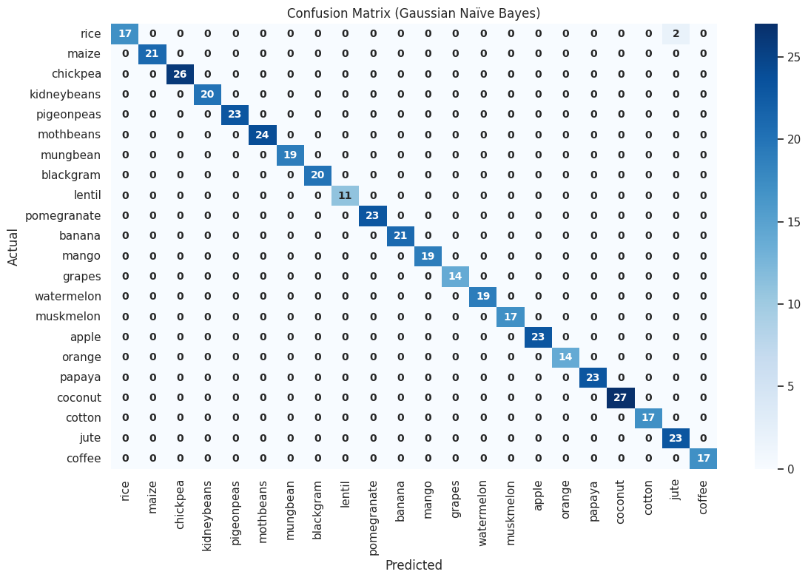
Gaussian Naïve Bayes Model Performance Analysis
Performance Metrics | Score (%)
Train Accuracy | 99.49
Test Accuracy | 99.55
Precision | 99.55
Recall | 99.55
F1-Score | 99.55
Fig. 9: Confusion matrix of Gaussian Naïve Bayes. Table. 4: Gaussian Naïve Bayes model’s performance metrics.
13/20

Slide 18

Support Vector Machine (SVM) Model Performance Analysis
Performance Metrics | Score (%)
Train Accuracy | 98.52
Test Accuracy | 96.82
Precision | 96.82
Recall | 96.82
F1-Score | 96.82
Fig. 10: Confusion matrix of SVM. Table. 5: SVM model’s performance metrics.
14/20

Slide 19

Decision Tree Model Performance Analysis
Performance Metrics | Score (%)
Train Accuracy | 100.00
Test Accuracy | 98.64
Precision | 98.64
Recall | 98.64
F1-Score | 98.64
Fig. 11: Confusion matrix of Decision Tree. Table. 6: Decision Tree model’s performance metrics.
15/20

Slide 20

Random Forest Model Performance Analysis
Performance Metrics | Score (%)
Train Accuracy | 100.00
Test Accuracy | 99.32
Precision | 99.37
Recall | 99.32
F1-Score | 99.32
Fig. 12: Confusion matrix of Random Forest. Table. 7: Random Forest model’s performance metrics.
16/20

Slide 21
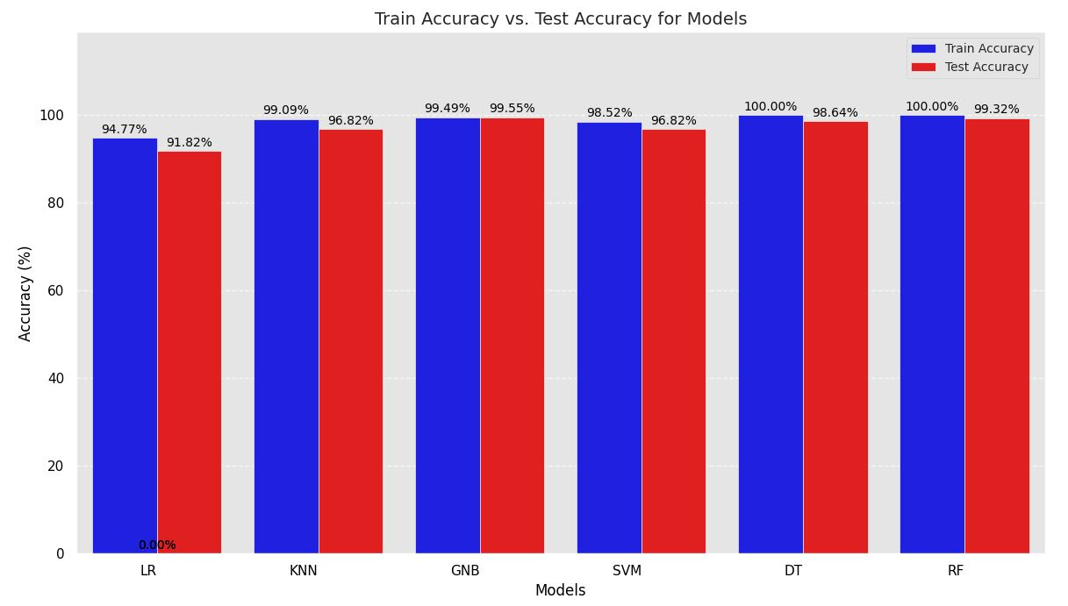
Model Accuracy Comparison
Fig. 13: Accuracy (%) comparison on train and test sets in bar plot.
17/20

Slide 22
Web Application
(Using Flask)

Slide 23
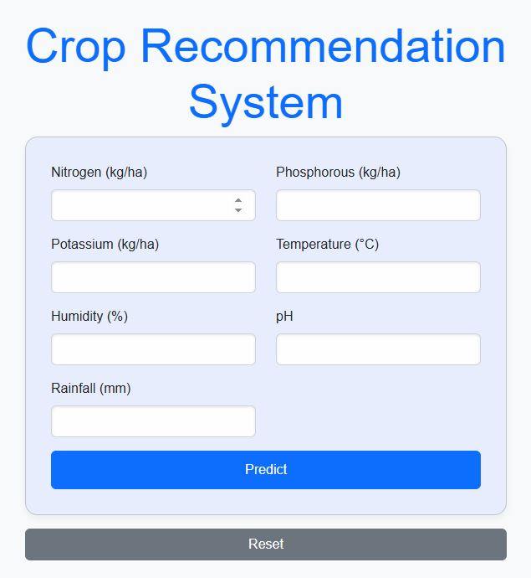
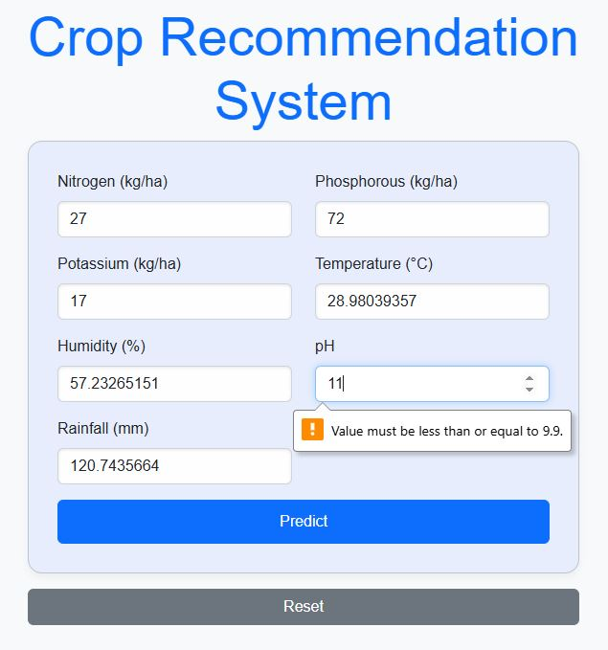
Web Application
Fig. 15: Front Page of the web application.
Fig. 16: Features requiring a realistic value.
18/20

Slide 24
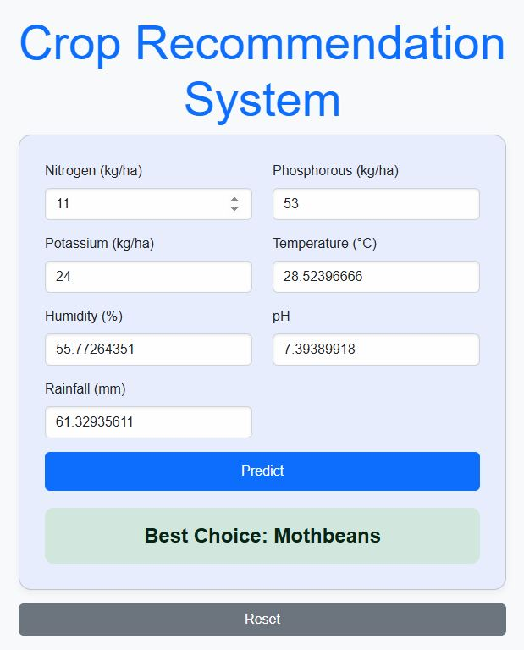
Web Application
Fig. 17: Prediction result in the web application.
19/20

Slide 25
Future Work
In the future, the intention is to:
Work with a large dataset.
Introduce more models and feature engineering techniques.
Focus on improving the overall accuracy.
Conclusion
This project focuses on creating a crop recommendation system using Python and machine learning to help farmers choose the best crops for their land. By analyzing soil quality, weather, and other environmental factors, it offers personalized, data-driven advice to boost productivity and reduce waste. The Flask-based platform empowers farmers to make smarter choices and improve their farming outcomes.
20/20

Slide 26
Thank You For Patiently Watching My Presentation

